Slide 1


WFH Solutions

Slide 2

ABOUT US
SkyBits Technologies, Is an Artificial Intelligence software development firm providing solutions and products to various global clients. It was founded by the veterans of the IT industry with immense global experience. The core focus areas for SkyBits are Image Processing and Natural Language Processing (NLP) based on strong foundations in Deep Learning technologies.

Slide 3
Management Team and Founders
Debabrata Dutta, Founder and Executive Director
Industry Experience: 30 Years
Past Organizations: DRDO, Wipro, Lucent, Ushacomm
Expertise: Machine Learning, Telecom, Parallel Computing,, Mobility
Education: M Tech Computer Sc. IISc Bangalore; B Tech Computer Sc. IIT Kharagpur
Satyajit Roy - Head of International Business Development
Industry Experience: 4 Years
Past Organizations: DNV, Go Marine, Early Stage Start-ups
Expertise: Technology Evaluation, Data analytics, management systems, Business Development, Six Sigma Black Belt
Education: Electrical Engineering and Economics from Pennsylvania State University
Ambar Mukerji, Executive Director
Industry Experience: 32 Years
Past Organizations: Lovelock/Flakt/Digital (DEC), Xerox, Telstra, UshaComm and early stage companies as CFO/COO/CEO.
Expertise: Financial and Business Management and Business Development and Financing
Education: Chartered Accountant

Slide 4
Tirthankar Banerjee – Advisor
Industry Experience: 30 Years
Past Orgs: Digital, Compaq, Sun, HCL Tech, HP
Expertise: Business Management, Machine Learning
Education: PGDM Marketing IMT; B Tech E&ECE IIT Kharagpur
Capt. Soumitro Roy - Advisor
Sujan Sinha – Advisor
Industry Experience: 40 Years
Past Orgs: Mobil, SCI, Reliance Industries, KOTC, ADNOC
Expertise: Commercial and operational Management of ships, Ani Piracy, Maritime training, Maritime software
Education: St Xavier's Kolkata, Master Mariner
Industry Experience: 37+ years
Past Organisations: SBI, Usha Martin Finance, Axis Bank, Shriram Housing Finance
Expertise: Retail Banking, Consumer Lending, Mortgages
Education: Presidency College, Kolkata
Nirendu Konar – Advisor
Industry Experience: 30 Years
Past Orgs: CISCO, SAIL, Wipro, Mastech, IBS
Expertise: Machine Learning, Deep learning, Business Analytics
Education: M Tech IIT Kharagpur, MBA University of Phoenix

Slide 5




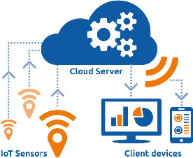


Solution & Technologies
Deep Learning
Statistical Analysis
Mobile Computing
and eLearning
Natural Language
Processing
Image Processing

Slide 6










Implemented Solutions
.
Prediction Modelling
CV Classification
E-KYC
Email and Document Classifier
Vehicle Recognition
Social feed Classifier
Chat Bot
Multi-Lingual Chat
Face Recognition
Drones

Slide 7






Solution Framework
Vehicle Recognition
Deployment
And Interfaces
Data Sources
Face Recognition
Data
On Premises
Cloud
Web API
Structured Data
Unstructured Rich data
Unstructured Data
Chatbots
Audio
classifier
Drone, store
Video analytics
Text Classifier
&
Summarization

Slide 8













Technology Stack
MOBILE TECHNOLOGY
NEAR REAL TIME ANALYTICS
MACHINE LEARNING
Generic/ Cloud

Slide 9
Technology & WFH (Work From Home)

Slide 10
WFH BASIC NEEDS
Measurable and Unbiased Appraisal System
Access to Company Questions
Corporate Needs
Video based attendance
Safe and Secure Video Conferencing option

Slide 11
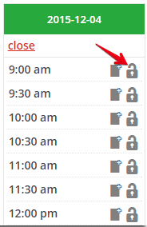



STAND ALONE CONFERENCE CALL
Existing Employees can schedule and login with their Corporate details
All group call can be recorded and saved into the corporate system if required
Video Consult
Clients and Prospective Job applicant can join meeting with secured links
Note: SkyBits Video Consult will be integrated with the corporate network and hence there will ne no need to use any other 3rd party video conference system which could lead to a data breach.

Slide 12




HR CHATBOT
Checking Balance Leaves
Requesting for leaves
Company news flashes
Company policies
Company newsflash
SKY CHAT
Complaint portal
Other HR activities

Slide 13

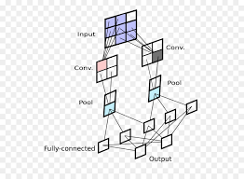


VIDEO ATTENDANCE
Authorized Person
Attendance Recorded
Convolution Neural Network
Unauthorized Person
Alert sent

Slide 14




RESUME CLASSIFIER
ML Algorithms reads JD &
scans list of CVs & web crawls through partner sites for matching CVs
Shortlisted CVs are ranked
Using Linear regression &
Latent semantic analysis
Only the top ranked
shortlisted individuals
are interviewed
HR receives Job
description from
respective department

Slide 15



APPRAISAL REVIEW SYSTEM
Number based Performance dEvaluation
Performance Benchmarking
KEY PERFORMANCE INDEX
Fact based
Uniform Measuring System
PERFORMANCE INDEX
Unbiased
Instant
Employee

Slide 16
Other Solutions

Slide 17



ADMIN – DOCUMENT & EMAIL MANAGEMENT
Email Classification & routing to appropriate group based on content
Automatic document Cataloging, legacy data digitization and categorization for easier search.
Document Matching Solutions, by extracting information from documents. Coupled with Facial recognition, can be used in E-KYC verification

Slide 18

















Using Machine Learning in Digitization of Forms
1
Scan new documents
Documents from Current system
Upload Image
2
Key-Value
Extraction
Supporting
Documents
Image
enhancement
Extraction of
printed data
Extractions of
key – value pairs
Extracted
Data
Extract to tables
Audits
3
Location
Compliance
Data Validations
Other
validations
Photo
Verify
Validation OK
At Field or Branch
Extract to tables

Slide 19



SOCIAL FEED CLASSIFIER
& RECOMMENDATIONS
Product Review Summarization based on feedbacks from social media / forums
Product recommendations based on past usage, patterns and statistical analysis
Automatic Customer Feedback Handling from company sites / social media; Routing

Slide 20




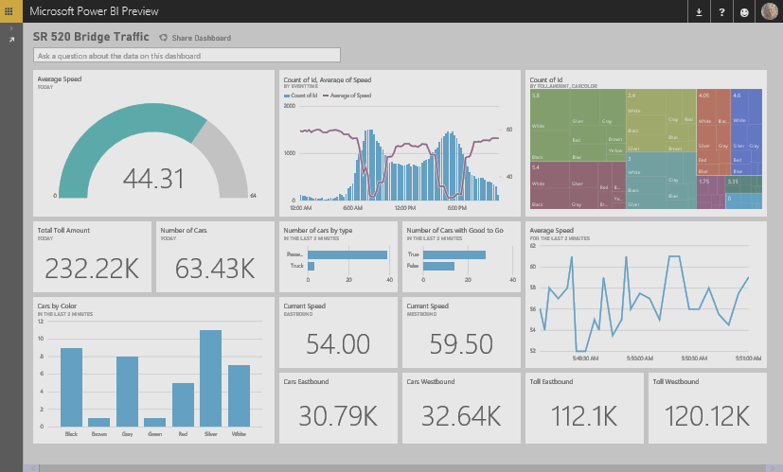

Automatic Handling of Customer Feedbacks
System Waits for new email and sends to the Classifier
Machine Learning
Based Classifier
Categorise reviews
based on feedback
Customer sends email to Customer Care
Take Appropriate Action
Based on Business Logic
Live Dashboard using streaming data

Slide 21






OUR CLIENTS

Slide 22
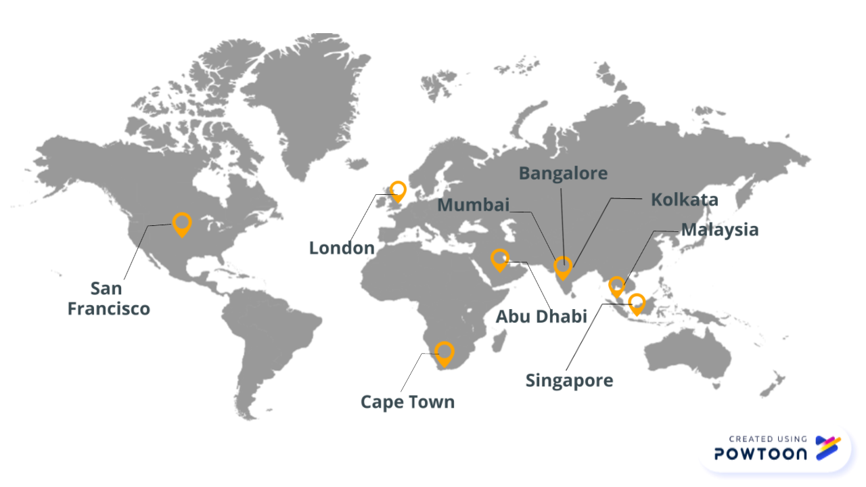
OUR GLOBAL PRESENCE

Slide 23
CONTACT US
+91-33-4000-3881
info@sky-bits.com
1416 DLF Galleria, Action Area 1B, New Town, Kolkata 700156, India
Visit us : http://sky-bits.com/

